Slide 1
Cecelia Friedman Levin, Esq., ASISTA
Cynthia Henning, Esq., KIND
Leslye E. Orloff, Esq., NIWAP
Victoria Hernandez, Esq., Ayuda
Immigrant Survivors
of Domestic And Sexual Violence in Family Court Matters
Addressing the Multiple Dimensions of Domestic Violence in Family Court
October 12, 2018
Notes:
Immigrant Survivors of Domestic/Sexual Violence in Your Courtroom: Family Court and Civil Protection Order Cases

Slide 2
Learning Objectives
At the end of this webinar, participants will be better able to
Recognize dynamics of immigration related-abuse in cases before the court
  Use legally correct information about survivor-based forms of immigration relief when ruling in family court cases
  Understand the court’s role in SIJS findings and U visa certificaiton and how immigration issues may impact family court proceedings involving surviviors of domestic violence, sexual assault, and child abuse

Slide 3
Immigration-Related Abuse
Notes:
Here can add some statistics..

Slide 4
Hypo – Clara
Clara is from El Salvador and came to the U.S. without documentation in 2010 with her daughter Elena. She fled because Elena’s father was physically and sexually abusive.
In 2012, she met Simon who was a U.S. citizen. They fell in love and had a daughter Sara. Simon promised he would file papers for them.
Simon became physically abusive to Clara and Elena. Simon told Elena that she had to work in a store that he managed, but she never got paid. He told Clara that if she called the police he would withdraw the papers and that she would be arrested because she was undocumented and she’d never see Sara again.
After one incident when Simon cut Elena’s arm with scissors, Clara left with both of her kids to her friend Sofia’s house. Sofia took pictures of the injury and took them to the hospital.
Notes:
What do you see as immigration related abuse?
Why might she be reluctant to call the police?

Slide 5
Barriers between Immigrants and Family Court

Slide 6
Barriers to Accessing Services
Language Access
Past experiences in home country
Fear of removal
Practical
Economic
Fear of family separation
Notes:
What barriers are you seeing in your courtroom?
Practical Factors: Survivors face difficulties accessing protection and services due to isolation, lack of knowledge of resources/rights, lack of a support network and language barriers
Cultural Factors: Survivors may not seek assistance due to cultural perceptions of law enforcement, court system, outside assistance, divorce, or if domestic violence denied/excused in their culture or for fear of disgrace.
Economic Factors: Survivors are often economically dependent on the abuser or do not possess work authorization
Legal Factors: Survivors often do not report abuse for fear of deportation, loss of custody of children, or retaliation from the abuser (e.g. withholding filings/documents). Immigration-related forms of abuse are pervasive.
Immigrant victims may have concerns about causing deportation of the abuser or perpetrator.
Access to a shelter, rape crisis center, or talking to a lawyer = extremely unlikely
Access to a restraining order = unlikely, unless abuser violates order
Access to police = possibly, if abuser is eventually convicted of a crime
Immigrant victims may improve immigration status by cooperating with law enforcement.
Cooperating in the criminal investigation or prosecution of an abuser or perpetrator may increase the likelihood of obtaining legal immigration status via the U visa for victims of certain crimes.
Information/misinformation
Potential for deportation
Experience in the home country
Economic barriers
Cultural and religious pressure

Slide 7
Barriers to DV Victims from Abuser
Withholding work authorization
Keeping any money the victim earns
Threats of deportation; report to ICE
Threatening to hurt children in home country/kidnap children to home country
Withholding assistance – family-based proceedings
Immigration status threats
US children taken away, hide/destroy papers
Calling the victim a prostitute or “mail-ordered bride”
DV stigma and keeping marital and family problems “private”
“Machismo” culture
Abuser likely more proficient in English

Slide 8
Barriers Continued
Fear and Mistrust of Law Enforcement
Past negative experiences in U.S. and own countries
DV/SA crimes not taken seriously in home country
Fear that local police will report to ICE
Language Access/Cultural Issues
Difficult to report crimes/provide accurate accounts
Many agencies do not use interpreters
Police sometimes use abusers as interpreters
Children used as interpreters
Only person police talk to may be abuser’s family member or friend
911 operators don’t identify need for interpreter quickly enough
Fewer resources for LEP clients
Language reliance on non-LEP abusers

Slide 9
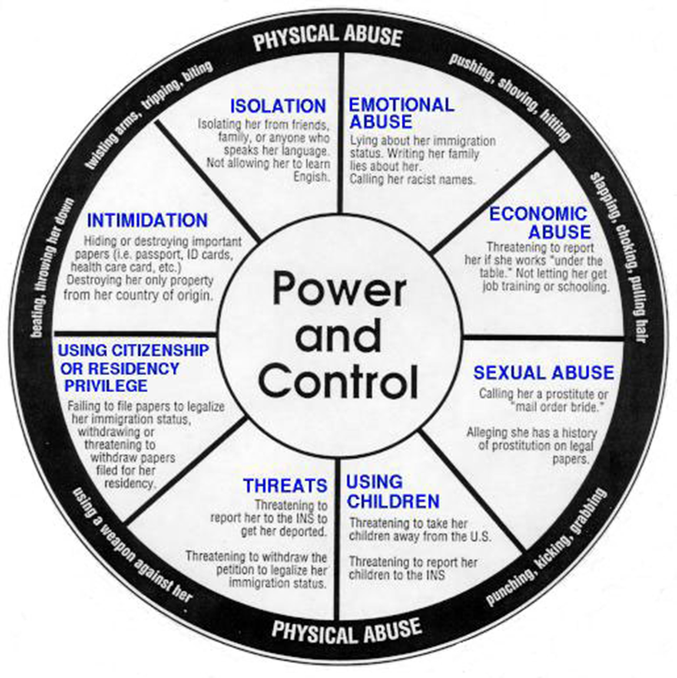
Immigrant
Power and
Control
Wheel

Slide 10
Cultural Competency

Slide 11
Cultural Competency
Cultural competency is a process
More than just factual knowledge of a culture
Includes ongoing attitudes towards both our clients and ourselves
Works to increase self-awareness of our biases and perceptions
Teaches us how to put aside biases and learn from clients
Cultural humility
There are limits to cultural competency

Slide 12
Why is Cultural Competency Important?
Helps us understand…
…a client’s actions and responses to violence
…a client’s responses to universal experiences (like death)
…how domestic violence uniquely affects survivors
…and identify the most appropriate resources for survivors of violence
Cultural competency and historical understanding are NOT excuses for the perpetuation of violence.

Slide 13
Continued
For clients:
Disclose information that they would normally be scared to
Trust the provider’s advice and believe that the provider is serving the client’s best interest
For providers:
Recognize triggers for the client
Identify issues that may not be recognized as abuse
Educate the client about differences between the
  U.S. legal system and their country’s legal system
Engage in culturally-specific safety planning

Slide 14
VAWA Confidentiality Protections

Slide 15
VAWA Confidentiality Protections: 8 USC § 1367
Non- Disclosure
Protections Against Enforcement Based on Abuser-Provided Information
Location Prohibitions
Protects victims who have filed a protected case with DHS
Includes family members and agents of abusers, crime perpetrators
Requires:
Enforcement actions at protected locations must state how they complied with VAWA confidentiality
Violation = $5,000 fine and/or disciplinary action
Protects:
*All victims abused by a spouse or parent- no filing required
*U visa and T visa victims in the process of filing are covered
*Filing immigration case enhances protection
© NIWAP
Notes:
: Enforcement locational prohibitions unless comply with specific statutory and policy safeguards – includes courthouses in cases involving immigrant crime victims

Slide 16
Location Prohibitions under 8 USC § 1367
Enforcement actions are not to be taken at the following locations unless ICE can certify in writing it complied with 8 USC § 1367 protections:
  Shelter
  Rape Crisis Center
  Supervised Visitation Center
  Family Justice Center
  Victim service provider or program
  Community based program
  Courthouse in connection with any
    Protection order case, child custody case, civil or criminal case involving or related to domestic violence, sexual assault, trafficking, stalking

Slide 17
Why is VAWA Confidentiality Important for State Courts?
Perpetrators are using state court discovery to obtain federal VAWA confidentiality protected information that
  DHS will not release
  Cannot be released under federal law
Confidentiality protections apply to family, civil and criminal court discovery
VAWA confidentiality’s limitations on courthouse immigration enforcement in cases involving immigrant crime victims
Notes:
Leslye

Slide 18
Courthouse Enforcement
ICE Policy on Courthouse Enforcement
  Courthouses not included in sensitive location policy
  Enforcement Actions should be targeted
  To the extent possible occur in non-public places
  Seeking individuals considered priority enforcement
  ICE will generally not target victims, witnesses and people accompanying others to court
  ICE need Field Officer/Special Agent in Charge permission for enforcement actions in non-criminal cases, courthouses (e.g., family court, small claims court) proceedings.
    Must check VAWA confidentiality data base
Notes:
In those instances in which an enforcement action in the above situations is operationally necessary, the approval of the respective Field Office Director (FOD), Special Agent in Charge (SAC), or his or her designee is required.

Slide 19
Steps Courts Are Taking
Restrict activities that interfere with courtroom operations
Enforcement restricted to non-public areas of the courthouse*
Courts ask ICE to coordinate with court security staff and use of non-public entrances & exits*
Some courts do not allow ICE into courtrooms
No enforcement in civil and family proceedings absent written authorization from ICE Field Office Director or Special Agent in Charge*
No interruptions during court proceedings or until case is completed
No enforcement against victims, witnesses, family members, people accompanying others to court*
Call courthouse security if ICE fails to comply with court orders
*= derived from DHS policy

Slide 20
Clara continued
Clara files for custody of Sara.
Simon responds that he wants full custody of Sara because Clara is undocumented and so not allowed to legally work to support their daughter.
Simon also alleges Clara will take Sara back to her home country.
Simon alleges fraud, stating that Clara only married him for papers.
Notes:
Judge Breall---bring
CA—reunifiying families act—exclusion immigration status.
WA—don’t consider imigration status.

Slide 21
Coercive Control Over Immigration Status
Among abusive spouses who could have filed legal immigration papers for survivors:
  72.3% never file immigration papers
  The 27.7% who did file had a mean delay of 3.97 years. Hass, Dutton and Orloff, "Lifetime prevalence of violence against Latina immigrants: Legal and Policy Implications." 93113, 7 International Review of Victimology (2000)
Perpetrators actively report victims for removal
  VAWA 38.3%; U visa 26.7% Rodrigues, Husain, Couture-Carron, Orloff, Ammar, “Promoting Access to Justice for Immigrant and Limited English Proficient Crime Victims in an Age of Increased Immigration Enforcement: Initial Report from a 2017 National Survey” (2018)
65% of immigrant survivors report some form of immigration related abuse (NIJ, 2003) Edna Erez and Nawal Ammar, Violence Against Immigrant Women and Systemic Responses: An Exploratory Study (2003)
*

Slide 22
Immigration Protections for Survivors

Slide 23
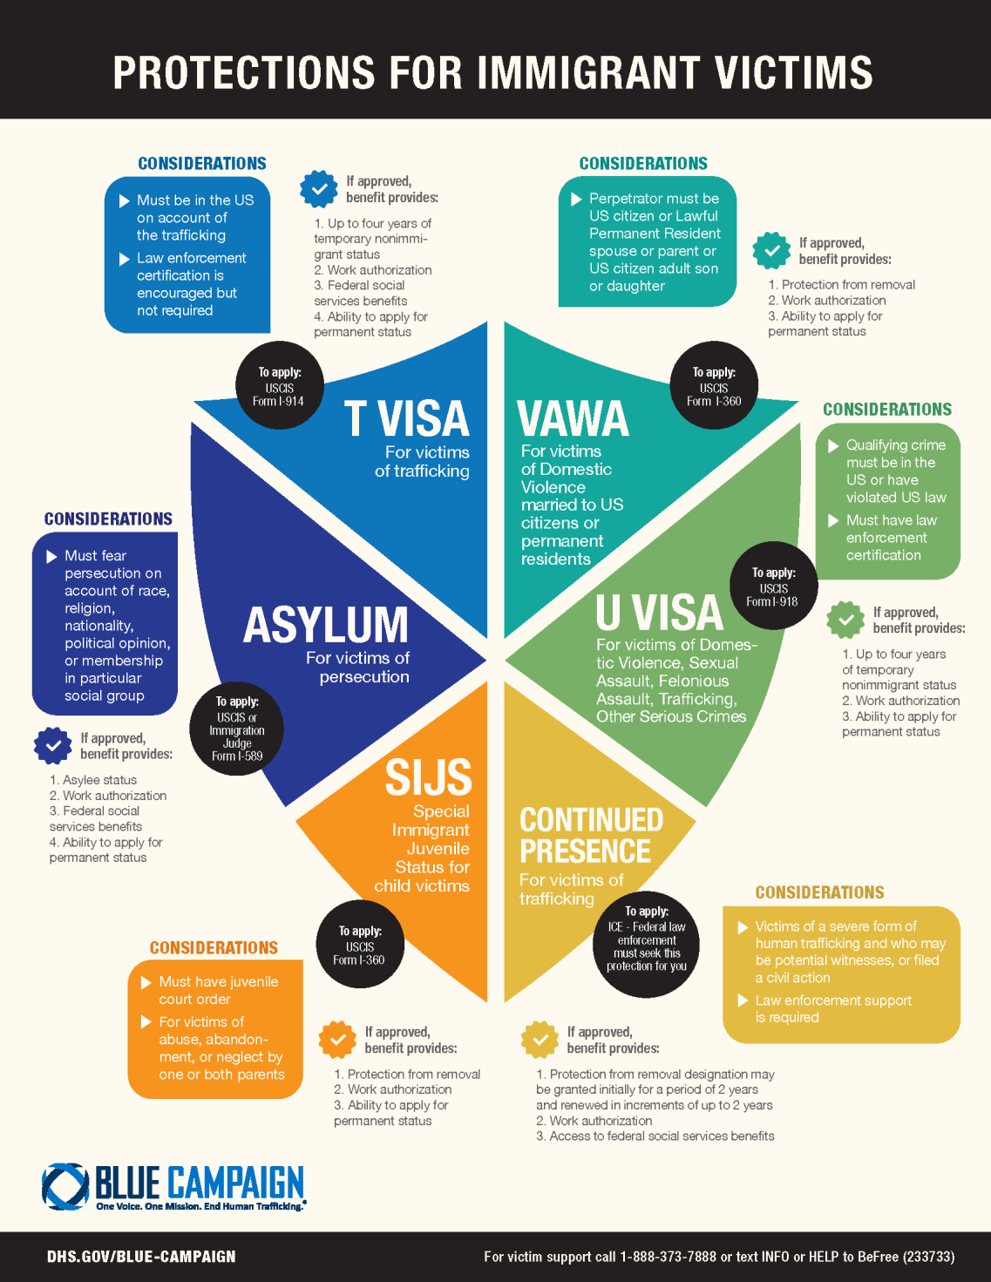

Slide 24
VAWA Self-Petitioning Requirements
Subjected to Battery or Extreme Cruelty
By a U.S. Citizen or Permanent Resident
  spouse;
  parent; or
  citizen adult son/daughter (over 21)
With Whom Self-Petitioner Resided
  No time period required
Good Moral Character
Good Faith Marriage
Notes:
Extreme Cruelty: Intimidation, Social Isolation Humiliation, insults, Possessiveness, stalking
Harm to pets, Minimizing, Denying & Blaming, Emotional Abuse, Economic Abuse, Coercion , Threats of deportation

Slide 25
U Visa Requirements
Victim of a qualifying criminal activity
Has been, is being, or is likely to be helpful in
  Detection, investigation, prosecution, conviction or sentencing
Suffered substantial physical or mental abuse as a result of the victimization
Possesses information about the crime
Crime occurred in the U.S. or violated U.S. law
25
25
25

Slide 26
U Visa Qualifying Criminal Activity
Domestic violence
Sexual assault
Rape
Incest
Prostitution
Torture
Felonious assault
Manslaughter
Murder
Female genital mutilation
Kidnapping
Abduction
Trafficking
Involuntary servitude
Slave trade
Being held hostage
Fraud Foreign Labor Contracting
Peonage
False Imprisonment
Blackmail
Extortion
Witness tampering
Obstruction of justice
Perjury
Stalking
Notes:
Leslye

Slide 27
T Visa for Trafficking Victims
A victim of a severe form of trafficking in persons
Victim is physically present in the U.D. on account of trafficking
Victim must comply with reasonable requests for helpfulness in investigating or prosecuting trafficking. Exceptions
  Under age 18
  Physical or psychological trauma impede helpfulness/cooperation
Removal from the U.S. would cause extreme hardship
Notes:
Leslye

Slide 28
Special Immigrant Juvenile Status (SIJS)
Immigration relief for unmarried children under 21
Who are victims of abuse, abandonment, neglect
  By at least one parent
To apply, child must submit required findings from a state court with jurisdiction over
  the care, custody, or dependency of the child
Notes:
Loretta

Slide 29
Asylum
Protects those fleeing persecution in their home countries
Legal Analysis is complex and constantly changing
Litigated in Asylum Office and in Immigration Court; jurisdiction depends on whether applicant is in removal proceedings
Did strongly protect victims of Intrafamily Violence who came to US fleeing their perpetrator
  BUT Recent Attorney General Decision Matter of AB overturned strong caselaw and tries to foreclose asylum for those fleeing private violence
  Advocates are using other legal arguments to try to protect victims of child abuse and gender-based violence

Slide 30
Judges and U Visas

Slide 31
Judicial Role
Make detailed findings
  Family relationships: Marriage and Parent child relationship
  Battering, extreme cruelty, child abuse, elder abuse, child abandonment, neglect, sexual assault, stalking
  Apply and cite state law
Role Congress created for state court judges in
  U/T visa certification
  Special Immigrant Juvenile Status findings
Distribute DHS produced know your rights information available at your courthouse

Slide 32
U/T Visa Certification: Who Can Certify?
Federal, state, and local
  Police, sheriffs, FBI, HSI, ATF…
  Prosecutors
  Judges, Magistrates, Commissioners, Judicial Referees, Masters, Alderman, ALJs, Surrogates, Chancellors
Departments of Labor (DOL) and the Equal Employment Opportunity Commission (EEOC)
Child and Elder Abuse investigators and agencies
Other government agencies
Judicial Training Network
32
Notes:
Leslye Anyone with delegated authority form and state, local, tribal or territorial court to deiced cases
OTHER = Any government agency that has the authority to detect, investigate, prosecute, convict or sentence based on facts related to criminal activities covered by the U or T visa

Slide 33
Court Receives Evidence of “Criminal Activities” in
Family Proceedings
  Civil Protection
  Custody
  Divorce
  Paternity
  Adoption
Juvenile Proceedings
  Child Abuse, Neglect, or Termination of Parental Rights
  Delinquency
Criminal Proceedings
Probate Proceedings
  Elder / Dependent Adult Abuse
  Guardianship
  Conservatorship
Civil Proceedings
  Employment
  Tort damages against a perpetrator
Notes:
Breall/ Livingston

Slide 34
Why victims seek certification from courts
Victim’s only justice system contact was a protection order, custody, or civil case
No language access when called police for help
Police did not investigate and case never sent to the prosecutor
34
Notes:
Leslye/Livingston

Slide 35
U/T Visa Certification Tells USCIS:
According to DHS, Certifications Verify that:
Certifier believes the applicant is a victim of a qualifying criminal activity
Victim had knowledge of the criminal activity
Victim was, is, or is likely to be helpful in the detection, investigation, prosecution, conviction or sentencing

Slide 36
Helpfulness Requirement Met Even When:
Victim reports a crime and there’s no further investigation
Report is of past crime that the victim did not report at the time
Perpetrator absconds or is deported
Perpetrator is being prosecuted for a different crime
Victim is not needed as a witness
Victim is dead (indirect victim is applying)
Perpetrator is dead
The criminal case did not result in a guilty plea or conviction
Victim is applying for a civil protection order, but domestic violence is not being criminally prosecuted

Slide 37
Evidence of Helpfulness in Family/ Civil Cases
Filed and/ or appeared at hearing for full protection order
Plead and or testified about abuse or sexual assault in a court case (e.g. protection order, divorce, custody, small claims, housing, employment)
Evidence in case that victim called the police, made a police report, cooperated in a criminal investigation
Serving the perpetrator with notice of case with underlying abuse facts
Notes:
Breall/ Livingston

Slide 38
Judges and
Special Immigrant Juvenile Status
Humanitarian protection that provides a path to lawful permanent residency for children

Slide 39
SIJS in the Family Court
Congressional Design:
  In its creation in 1990, Congress wanted findings of child abuse, neglect, abandonment, and best interests made by child welfare experts – have judges of “Juvenile Courts” apply their states’ laws
  Amendments in 1993 and 2008 have kept this important role in place
DCSC Family Court is a “Juvenile Court” authorized to make SIJS findings
  In re C.G.H., 75 A.3d 166 (D.C. 2013)
  Children eligible for SIJS come before the Family Court in:
  DR Proceedings: Caretaker asking for custody
  NEG proceeding

Slide 40
Intrafamily Violence and SIJS
Special Circumstances in DR cases: children’s testimony about abuse, neglect, or abandonment might be the only available evidence on those issues
  DCSC judges usually exclude others from the Courtroom, allow child to testify at table instead of witness box
  Attorneys have to balance meeting evidentiary burdens with the retraumatization of testifying for the child
Children in SIJS Custody cases: If abuse or neglect present in case, children have likely been victims of physical, sexual, or emotional abuse OR have witnessed abuse against caretakers and siblings, even if not all comes out in evidence
Caretaker parents requesting custody could have been victims of intrafamily violence during the parties’ relationship, even if not highlighted in SIJS custody case

Slide 41
SIJS State Court Findings
State Court SIJS findings are a statutorily required prerequisite to an eligible child being able to file the SIJS immigration case
DHS uses the state court order as evidence in adjudicating the immigration application
The state court order does not award SIJS
  ONLY DHS can provide SIJS a form of legal immigration status and permanent residency

Slide 42
SIJS Findings
(1) Child is unmarried alien under 21 | - Usual evidence: testimony and birth certificates - Parentage: presumption of parentage from foreign birth certificate, D.C. Code § 16-909(c)
(2) Reunification of Child is not viable with one or both parents due to abuse, neglect, abandonment, or a similar provision under D.C. law | Apply definitions in D.C. Code § 16-2301, et. al, and caselaw Abandonment: See J.U. v. J.C.P.C., 176 A.3d 136 (D.C. 2018) (discussing three options for defining abandonment under D.C. law) - Usual Evidence in DR: Testimony from parties and child
(3) It is not in the child’s “best interest” to be returned to his or her, or his or her parents’, previous country of nationality or country of last habitual residence. | - Apply D.C. Code § 16-914(a)(3) - Usual Evidence in DR: Testimony from parties and child - Apply best interest factors to compare placements: potential custodians in each placement, any neglect findings of custodians, access to school and other services, etc.
(4) Child has been placed in an individual or entity’s custody, OR have been declared dependent, by a U.S. “Juvenile Court” | - D.C. has made SIJS findings in DR, NEG, ADA, DEL proceedings.
Notes:
Loretta

Slide 43
DC Caselaw
In re C.G.H., 75 A.3d 166 (D.C. 2013)
  Legally committing a child to an adoptive parent, even when one biological parent retains parental rights and custody, is sufficient to fulfill the SIJS factor requiring that a “court has legally committed [the child] to, or placed [the child] in the custody of…an individual…appointed by a…juvenile court”
  J.U. v. J.C.P.C., 176 A.3d 136 (D.C. 2018)
    Viable = practical or workable
    “whether reunification is viable due to abandonment [calls] for a realistic look at the facts on the ground in the country of origin and a consideration of the entire history of the relationship between the minor and the parent” [internal citations omitted]
    Discusses three definitions of abandonment in DC law, and that abandonment should be interpreted broadly in the SIJS context

Slide 44
DC Caselaw Continued
E.P.L. v. J.L.-A., No. 16-FM-991, 2018 D.C. App. LEXIS 341 (Aug. 9, 2018)
  A consent agreement for opposing party to have sole custody does not mitigate abandonment where father repeatedly failed to financially support, exercise right of visitation with, or establish a relationship with his child
  Where the Court has decided a custody placement under the best interest standard with a custodian in D.C., it logically follows that it would not be in the child’s best interest to return to their home country (where there is no custodian)
Del Carmen Benitez v. Doe, No. 16-FM-929, 2018 D.C. App. LEXIS 393 (Sep. 6, 2018)
  In SIJS context, distinct from termination of parental rights context, knowledge of parentage is not a requirement for abandonment, similar to the neglect context where lack of knowledge of parentage does not stop a neglect finding
  **Court reviews decisions of A/A/N , viability of reunification, and best interest under de novo standard because they are legal determinations under D.C. law

Slide 45
Increased Pressure from USCIS
Since late 2016, USCIS has been aggressively making changes to their policies, procedures, and methods of evaluating all applications, including SIJS
USCIS has increasingly issued:
  RFE’s (Request for further Evidence) – identifying evidence USCIS wants to consider for the application
  NOID’s (Notice of Intent to Deny) – identifying reasons for intended denial and last opportunity to fix
  Strong Advocates carefully craft proposed orders and try to keep up with latest trends – however, because of rapid changes, might have to file Motions to Amend State Court Orders for submission with USCIS
  As of September 12, 2018 – USCIS’s new policy is to just deny cases instead of issuing RFE’s and NOID’s, except in very limited circumstances
  Issue for Priority Dates (date of filing SIJS) – delays ability to file for LPR

Slide 46
Best Practices for State Court Order
Address each SIJS finding individually
Issue a separate order for each child
Apply and Cite state law for all findings
For findings of abuse, abandonment and/or neglect:
    Separately analyze allegations regarding each parent
    Can use facts of A/A/N occurring abroad and/or in the U.S.
  Best interest of child not to return to country of origin
    Articulate factors weighed to determine this, including positive factors in Court’s custody placement
  Articulation of trauma impact on child helpful
  Connect the dots between the Court’s rulings and protection of a child survivor of abuse, neglect, or abandonment

Slide 47
What happens after my Courtroom?
Child applies for SIJS with USCIS
Attends Immigration Court hearings in Arlington
  If child has arrived since 2014, they are most likely in removal proceedings
  While Arlington used to terminate cases where children had predicate orders, now because of DHS attorney opposition and appeals, will only terminate once a Visa for Permanent Residency becomes available
  Status Docket – scheduling for 2019 and 2020 when awaiting SIJS approval or a visa for LPR
Applies for Permanent Residency (LPR) when visa becomes available

Slide 48
Immigration Consequences of
SIJS Findings against Parents
  Civil Findings of abuse/neglect/abandonment by Family Court Judges
    While Court is determining viability of reunification, no termination of parental rights required in these cases for SIJS
    (USCIS Policy Manual, Vol. 6, Part J, Ch. 2, 09/26/2018); see also Del Carmen Benitez v. Doe, No. 16-FM-929, 2018 D.C. App. LEXIS 393 (Sep. 6, 2018).
  Immigration Consequences
    Have not seen ICE target parents for SIJS findings against them so far
    ?’s under Penalty of Perjury on applications: Whether applicant has failed to support dependents or has withheld custody of a US citizen child outside of US from a US citizen granted custody
  Arrest for Contempt of Court – ICE priority to detain those arrested or charged; fingerprinting by law enforcement is connected to ICE databases
  Executive Order, Enhancing Public Safety in the Interior of the United States, 1/25/17

Slide 49
Immigrant Litigants in Family Courts

Slide 50
Divorce

Slide 51
Impact of Divorce
VAWA self-petitioners
  Must file within two years of final divorce
  Step-children must file before divorce
Ends legal immigration status for spouses and children of visa holders:
  Students, Persons with legal work visas, Diplomats
Divorce cuts off access to lawful permanent residency for spouses and children of people seeking lawful permanent residency based on:
  Asylees
  Employment visa holders
  Family based visas
  Cancellation of removal

Slide 52
Annulment Instead of Divorce
Annulment can lead to a marriage fraud finding that:
  Permanently bars approval of any visa petition
  Is a ground for deportation
  Can lead to an unfavorable exercise of discretion by an immigration judge not to grant immigration relief
Impact on
  Spousal support
  Property division

Slide 53
Custody

Slide 54
Protecting Immigrant Survivors Protects Children
The co-ocurrence of DV and child abuse in a household drops significantly (77% to 23%) when immigrant DV survivors receive help
Children of help seekers are 20% less likely to have mother’s abuser threaten them
Children of help seekers are one-third less likely to have abuser threaten to take them away from their mother
Ammar, Orloff, Hass and Dutton, “Children of Battered Immigrant Women: An Assessment of the Cumulative Effects of Violence, Access to Services and Immigrant Status.” (September 2004) http://niwaplibrary.wcl.american.edu/pubs/co-occurencedvchildabuse/

Slide 55

Is Immigration Status Relevant to Custody?
Relevant to: Immigrant crime victim presents evidence of immigration related abuse, power and control suffered
  Either not filing or withdrawing immigration papers
  Threats to turn victim in for deportation
  Part of history of violence
Not relevant to:
  Core primary caretaker determination
  Evaluation of parenting skills
  Best interests of the child determination
  Requirements regarding custody awards to non-abusive parent
Notes:
RG

Slide 56
ABA Center on Children & The Law
“Parties should not be able to raise, and courts should not consider, immigration status of domestic violence victims and their children in civil protection order, custody, divorce or child support proceedings.”
“Batterers whose victims are immigrant parents use threats of deportation to avoid criminal prosecution for battering and to shift the focus of family court proceedings away from their violent acts…When the judicial system condones these tactics, children suffer.”
“This … will ensure that children of immigrant domestic violence victims will benefit from …laws (like presumptions against awarding custody or unsupervised visitation to batterers) in the same manner as all other children.”
Notes:
RG

Slide 57
Myth vs. Fact:
Parents without Legal Immigration Status
Myth
Fact
Deportation is imminent
Parent is likely to flee U.S. with child
The parent has no livelihood
Legally present parent must have custody in order to file for benefits for child
DHS policies prevent detention/removal of immigrant parents who are crime victims
US citizens and lawful permanent residents are more likely to flee with children, especially when
  There have been threats of kidnapping children
  They are dual nationals
  They travel freely to and from U.S.
Abused immigrant parents in family court have a path to immigration relief, work authorization & some benefits
Custody does not affect parent’s ability to file for or gain immigration benefits for his children.
Notes:
LY

Slide 58
Immigrant Parents and Child Custody
Parents have a Constitutional right to custody (absent unfitness)
Applies to all families without regard to:
  Undocumented immigration status
  Immigration detention
  Deportation
Overriding presumption that:
  Parent-child relationship is constitutionally protected
  In children’s best interest to stay with/be reunited with their parent(s)
Child’s best interests is most important
  A comparison of natural vs. adoptive parent’s cultures, countries or financial means is not to be made
  In re Interest of Angelica L., 277 Neb. 984 (2009)
Notes:
Leslye

Slide 59
Potential Consequences of DV/SA
Deportation
Bar to Lawful Permanent Residence
Bars to Naturalization (good moral character)
  When would this apply?
For US Citizens- (Adam Walsh Issues)
  Barrier to immigrating fiancées
  Bar to immigrating spouses and children
Notes:
When DV is CIMT…
Noncitizen is deportable under DV ground if convicted of
Crime of domestic violence
Crime of violence (18 USC 16) + committed against victim with protected domestic relationship
Crime of child abuse, neglect or abandonment
Stalking or
If civil or criminal court violated certain sections of protection order
A noncitizen is deportable under the ‘domestic violence deportation ground” if he or she is convicted of the following: A) a crime of domestic violence; B) a crime of child abuse, neglect or abandonment, or C) stalking; or D) if found in civil or criminal court to have violated certain sections of a domestic violence protective order. 8 USC § 1227(a)(2)(E).
Stalking, child abuse, neglect, abandonment
Crime of DV = crime of violence (18 USC § 16)
Use or threatened use of force
Committed by person covered by state DV laws
Waiver only for victim (not primary perpetrator)
the conviction is a “crime of violence” as defined at 18 USC § 16 which is (b) committed against a victim with a protected domestic relationship as defined in the deportation ground.
Protected relationship: against a person committed by a current or former spouse of the person, by an individual with whom the person shares a child in common, by an individual who is cohabiting with or has cohabited with the person as a spouse, by an individual similarly situated to a spouse of the person under the domestic or family violence laws of the jurisdiction where the offense occurs, or by any other individual against a person who is protected from that individual’s acts under the domestic or family violence laws of the United States or any State, Indian tribal government, or unit of local government.
Violated CPOs: Any alien who at any time after admission is enjoined under a protection order issued by a court and whom the court determines has engaged in conduct that violates the portion of a protection order that involves protection against credible threats of violence, repeated harassment, or bodily injury to the person or persons for whom the protection order was issued is deportable. For purposes of this clause, the term “protection order” means any injunction issued for the purpose of preventing violent or threatening acts of domestic violence, including temporary or final orders issued by civil or criminal courts (other than support or child custody orders or provisions) whether obtained by filing an independent action or as a pendente lite order in another proceeding.
Notice: Padilla v. Kentucky,130 S.Ct. 1473 (2010)
Attorneys - affirmative obligations to tell the defendant about immigration and removal.
Judges have obligation to ask the attorneys if they have done so.
Judges should give admonitions about deportation and barriers to naturalization, and right to contact consulate (Vienna Convention).
Plea agreements should be for crimes having a maximum possible sentence of less than a year imprisonment.
Barrier to naturalization?
CPO violation?
Right to notify consulate?
Referrals to agencies/attorneys?
Padilla v. Kentucky,130 S.Ct. 1473 (2010)
Fiancé sponsors must reveal convictions to DHS and CPOs to marriage brokers
DHS may to background checks
Must reveal CPO to fiancé

Slide 60
Non-Citizen’s Access to
DC Public Benefits

Slide 61
Accessible Services for Aliens with Immigration Status in DC

Slide 62
Food and Housing
TANF & TANF funded childcare
  T visa applicants, continued presence (CP), refugees, asylees
  VAWA self-petitioners eligible + SIJS & U visa if lawful permanent residents eligible. 5 year bar if entered on or after 8/22/96
Food Stamps
  T visas (& their children)
  Under 18 year old children who are VAWA self-petitioners or SIJS/U visa with lawful permanent residency
Public and Assisted Housing & Vouchers
  T visas (& their children)
  VAWA self-petitioner (& children)

Slide 63
Health Insurance and Driver’s Licenses
CHIP and Medicaid subsidies
  T visas, refugees, asylees, CP (& their children) – 7 year limitation
  VAWA self-petitioner (& children), SIJS applicant children, and wait-list approved U visa applicants and lawful permanent residents
  Pregnant women receive health care without regard to immigration status
DC Health Care Alliance
  provides health care to income eligible persons without regard to immigration status
Driver’s license
  Limited purpose driver’s license to any person
  Federally recognized driver’s license
    U/T visa, asylees, refugee, any unexpired visa, work authorization

Slide 64
Education, Bills, and Disability
Educational Grants/Loans (FAFSA)
  T visas, VAWA self-petitioners (& their children)
  SIJS children, U visas after lawful permanent residency
In-state tuition and state financial aid regardless of immigration status
  For students who attended high school in DC for 3 years + graduation or GED,
SSI
  T visas, VAWA self-petitioners if lawfully residing on 8/22/96 and blind or disabled. Other lawful permanent residents 5 year bar + 40 quarters
LIHEAP
  VAWA self-petitioners, T visa, CP, refugees, asylees, SIJS/U with lawful permanent residency

Slide 65
How Immigration Backlogs Affect Services
Case Type | Asylum | SIJ- based adjustment to Legal Permanent Residency (LPR)
Approximate Time from Application to Resolution | Defensive Cases: 2-4 years at Arlington Immigration Court (colloquial from KIND) Affirmative Cases: AO + Court Arlington Asylum Office Priority scheduled case: 6-18 mo. Backlogged case: 4+ years (colloquial from KIND) | About 4-5 years total SIJS Application to LPR Application: 2-4 years LPR application – 18 months
When eligible for benefits requiring status | Once Asylum is Granted | Once LPR granted **SIJS is NOT legal status
When eligible to get work authorization | Apply after 120 days after asylum application submitted Get in 1-2 months after application | Once LPR application is pending Receive about 6-8 months after application

Slide 66
Backlogs Continued
Case Type | T visa | U Visa
Approximate Time from Application to Resolution | 12-15.5 months (USCIS website) | 2 years to Temporary Benefits for qualifying victim (USCIS website) 8 years for Approval – due to visa quota (colloquially, immigration community)
When eligible for benefits requiring status | Once HHS approves a OTIP Certification Letter, can be done without regard to T Visa application | CHIP/Medicaid – when Deferred Action is approved All else, T Visa granted + three years mandatory waiting period + 1.5 years for adjustment to permanent residency processed
When eligible to get work authorization | Once T Visa is approved | About 2 years after filing, if Deferred Action is approved for prima facie eligible applicant

Slide 67
Accessible Services for all DC Residents Regardless of Status

Slide 68
Public Benefits for ALL DC Residents
Shelter and transitional housing
Legal Services
Weatherization Assistance Program
Emergency Medicaid
Health care from community and migrant public health clinics
Victim services
Help from food kitchens
K-12 education

Slide 69
Any Questions?

Slide 70
Contact Information
Cecelia Friedman Levin
Senior Policy Counsel, ASISTA
cecelia@asistahelp.org
Cynthia Henning
Direct Representation Attorney, Kids in Need of Defense (KIND)
chenning@supportkind.org
Leslye Orloff
Adjunct Professor
Director of the National Immigrant Women’s Advocacy Project (NIWAP)
American University, Washington College of Law
orloff@wcl.american.edu
Victoria Hernandez
Domestic Violence/Family Law Supervising Attorney, Ayuda
VictoriaH@ayuda.com

